Slide 1


Supply Chain
This project evaluates the supply chain inefficiencies of a Supply Chain Company. We will analyze business performance, customer and product data, and inventory management. Our goal is to identify key issues and suggest data-driven solutions.

Slide 2

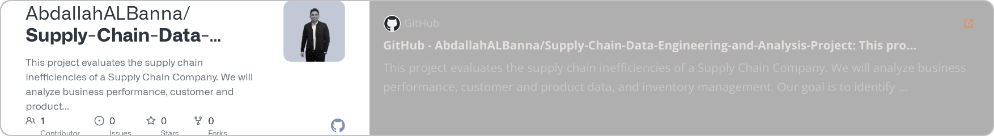
Our Team
Abdallah Albanna
Khaled Tarek Mohamed
Abdelrhman
Abdelrhamn
Ibrahim
samir
Mohammed Elmehy
GitHub Repository:

Slide 3

Table Of Content
1
Introduction
2
Database Design
3
ETL Process
4
DWH Design
5
Machine learning and visualization
6
Data analysis and visualization
7
conclusion

Slide 4
1-Introduction

Slide 5
Dataset Overview
This dataset offers an overview of the supply chain process by including key components like orders, products, customers, stores, sales transactions, and shipping logistics. Its star schema structure enables easy analysis and insights into the flow of goods and services.
1
Sales
2
Transactions
3
Customer Interactions :
Records of sales transactions, including order details, product pricing, discounts, and total sales amounts
Information on order IDs, item codes, and financial metrics such as earnings and profit per order
Data on customer profiles, including contact details, segmentation (e.g., Consumer, Corporate), and geographical locations
4
Shipping Logistics :
5
Product Management :
Insights into shipping times, including Real vs. scheduled delivery durations, shipping methods, and delivery status
Details on product IDs, names, descriptions, pricing, and availability status

Slide 6
Goals
1
Personalize Interactions
2
Evaluate Products
Use customer data to tailor marketing and enhance service.
Assess product performance to guide inventory and development decisions
3
Increase Revenue
4
Optimize Shipping:
Analyze sales data to refine pricing strategies, promotions, and sales tactics to boost overall revenue
Improve shipping accuracy and reduce delays by analyzing Real vs. scheduled shipping times
This project aims to leverage data-driven insights to drive improvements in operational efficiency, customer satisfaction, financial performance, product management, and market understanding

Slide 7
2-Database Design

Slide 8






Database Design
Collecting the data
Understanding the data
Design entity relation diagram
Design the mapping
Creating tables in SQL
Transfer the data to SQL

Slide 9

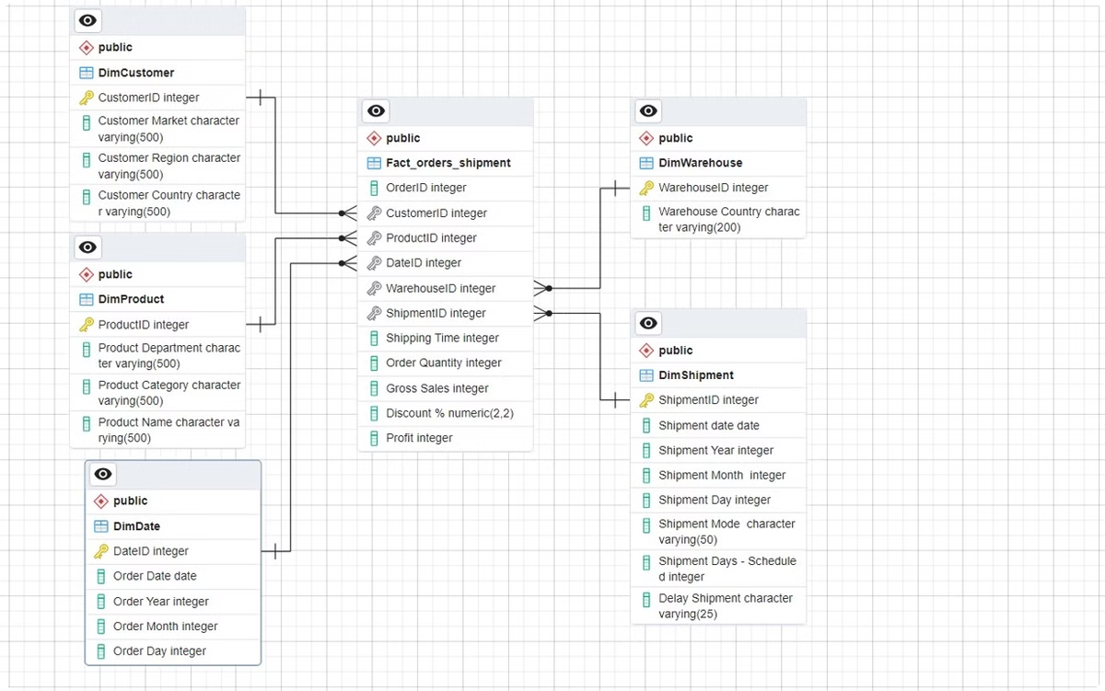
Design entity relation diagram (ERD)
We have categorized the data into groups such as orders, ordered items, products, customers, and categories, illustrating how they relate to one another for easier understanding of the data organization.

Slide 10
Design Mapping
Through mapping, we start collecting relevant data and linking it across different tables or entities in the database. This process is crucial for organizing information, particularly within the context of the supply chain.

Slide 11
3-ETL Process

Slide 12
ETL Process
ETL: Extract, Transform, Load process as the foundation of data flow.
Python: Used for ETL tasks, including data extraction, cleaning, and analysis.
Extraction Collect data from different sources, which may vary in format or location.
Transform: Clean and prepare the data by handling issues like missing values, human errors, and inconsistencies.

Slide 13
ETL Process
Create dimension tables and fact table and link them together.
Final load into the data warehouse for analytics and reporting using Power BI.

Slide 14
4-DWH Design

Slide 15

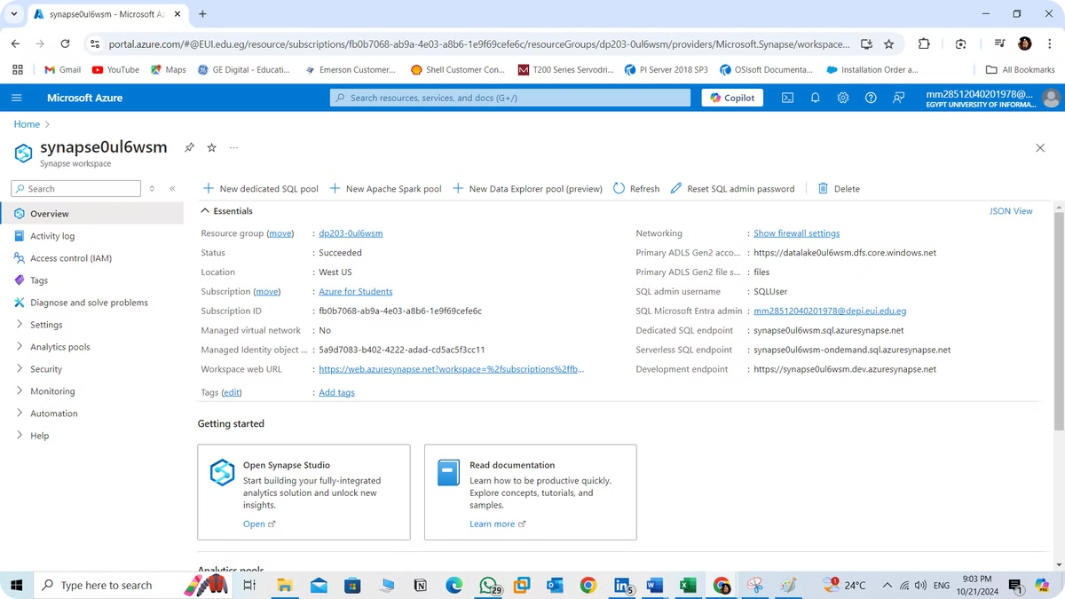
DWH Design
This part outlines the process of a Data Warehouse (DWH) using Azure Synapse Analytics to address business analysis needs through dimensional modeling. The project involves using Azure Synapse Analytics workspace, an Azure Storage account, and a Data Lake to store data files. Additionally, a serverless SQL pool was created for data loading and querying purposes.
The objectives are:
Design and implement a DWH using dimensional modeling.
Use Azure Synapse Analytics to store and manage data.
Load Fact and Dimension tables into the Synapse database for analysis.

Slide 16
DWH Design
An Azure Synapse Analytics workspace and an Azure Storage account were used to host the data lake and upload some data files to it, also, a serverless SQL pool in Azure Synapse Analytics was utilized for this purpose.
Fact Table: Contains measures or metrics like sales, profits, and order data.
Dimension Tables: Contain attributes that describe the facts, like products, fulfillment data, and time.
Star Schema Design: Create Fact and Dimension tables for optimized query performance. Why Star Schema? It simplifies queries and provides fast performance.

Slide 17
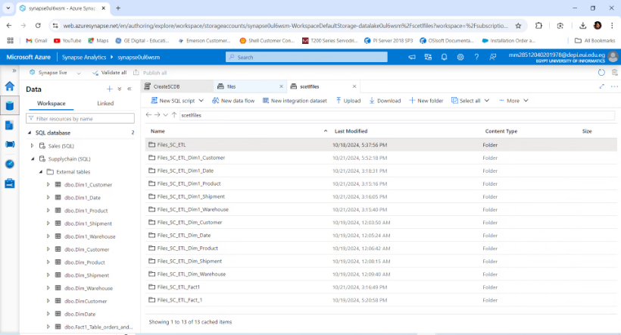
Fact and Dimension Tables on SQL DB Connected to Server less storage on Azure Synapse Workspace

Slide 18
5-machine learning and visualization

Slide 19
overview :
a project that applies data analytics and machine learning techniques to a supply chain management problem. Supply chain management involves overseeing the flow of goods and services, including all processes that transform raw materials into final products. Efficient supply chain management is essential for reducing costs, improving delivery times, and maintaining customer satisfaction.

Slide 20
Goal:
This project aims to leverage data to enhance decision-making processes in supply chain operations by applying machine learning models such as Random Forest Regression and Logistic Regression for Shipment Mode Prediction
This presentation presents two machine learning approaches—Logistic Regression and Random Forest Regression—applied to an Orders and Shipments Dataset.

Slide 21
Model Training and Fine-Tuning
Logistic Regression:
Random Forest Regression:
· Task: Predict the Shipment Mode from order and customer details.
· Task: Predict the Profit from sales-related features.
· Type: Regression (continuous outcome).
· Type: Classification (categorical outcome).
· Algorithm: Random Forest Regressor.
· Algorithm: Logistic Regression.
· Evaluation Metrics: Mean Absolute Error (MAE), Mean Squared Error (MSE), and R² score.
· Evaluation Metrics: Accuracy, Precision, Recall, F1-Score, and Confusion Matrix.

Slide 22
Step-by-Step Guide classification Shipment Mode Prediction And Profit Predict:
· Step 1: Importing Libraries:
Loading and Preprocessing the Dataset:
Step 3: Feature Selection and Train-Test Split:I. classification Shipment Mode:
· Step 4: Model Training and Fine-Tuning
We begin by importing the required libraries for data manipulation, model training, and evaluation
o We clean column names to avoid issues related to spaces
o Choose the Model: Train a language model (model name) on the preprocessed data
o X: Features that might influence shipment mode.
o Drop missing values: Rows where Profit is missing are removed.
o y: The target variable, Shipment Mode, to predict.
o We train the Logistic Regression model for the shipment mode on the training data
o Label Encoding: Categorical variables (like product and customer information) are encoded into numerical values using LabelEncoder.
o We split the dataset into training (70%) and testing (30%) sets
o We train the Random Forest Regressor for profit prediction with 100 trees (n_estimators=100) on the training set.
II. Profit Predict:
o X: Features that might influence Profit
· Step 5: Evaluating the Model
o y: The target variable, Profit, for prediction
o We evaluate the model using MAE, MSE, and R² score to measure how well the model predicts the continuous values
o The dataset is split into 80% training and 20% testing.
o Accuracy, Precision, Recall, F1-Score, and the Confusion Matrix help evaluate the model's classification performance

Slide 23
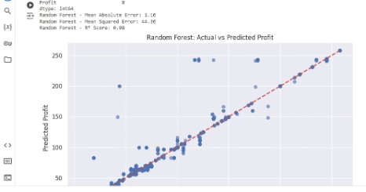
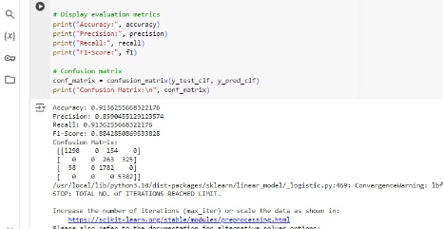
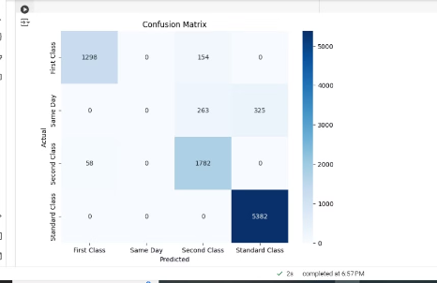
visualization
A scatter plot:
Evaluate the model:
is used to visualize the actual vs predicted profits. The red diagonal line represents perfect predictions, helping us assess the performance visually.
for the classification of shipment mode
Visualize the Confusion Matrix:
measure :
This uses Seaborn to create a heatmap of the confusion matrix, where each cell shows the number of true vs predicted classes.
1.accurecy 2.precision
measure profit prediction
3.recall 4.f1-score

Slide 24
6-Data analysis and visualization

Slide 25
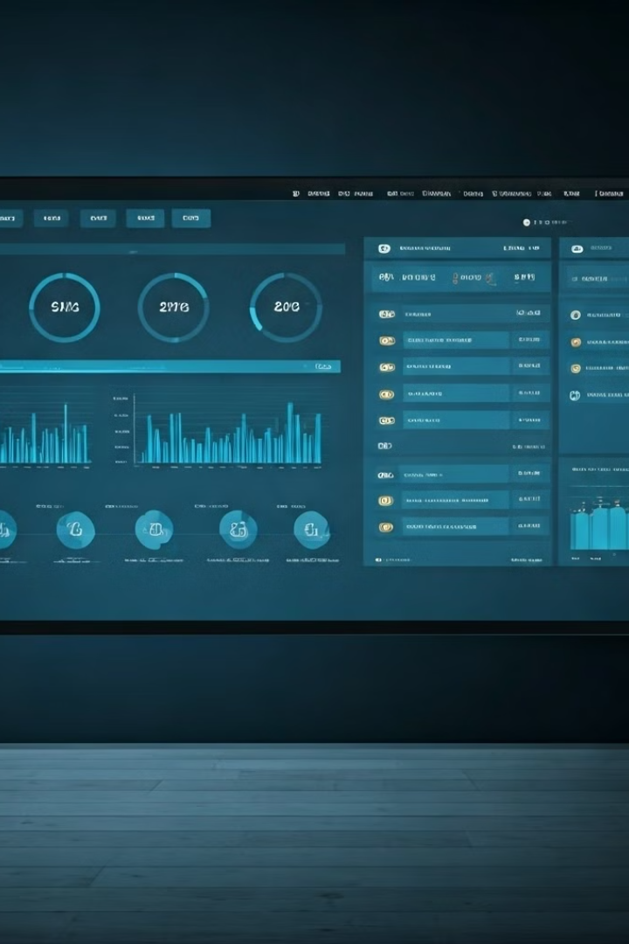




Goals & Insights
Business Performance
Product Analysis
Analysis of key financial metrics and overall company health.
Evaluation of product portfolio performance and market trends.
Inventory Management
Shipment Management
Assessment of current inventory practices and identification of improvement areas.
Overseeing daily shipping and distribution operations to customers

Slide 26
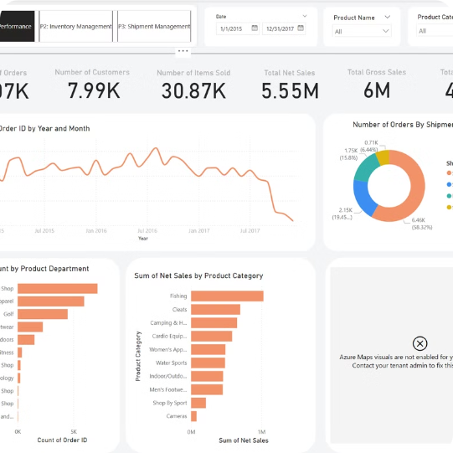
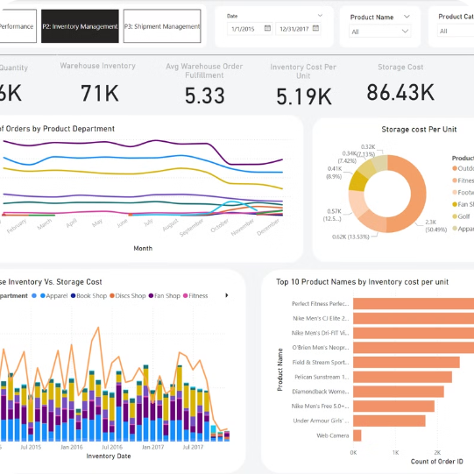
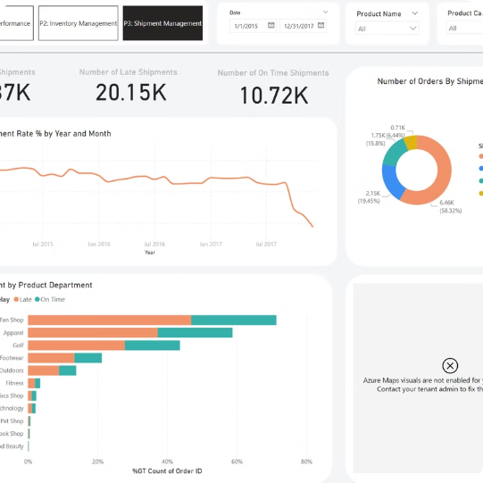
Power BI Dash Boards
Business Performance
Inventory Management
Shipment Management
Dash Board
Dash Board
Dash Board

Slide 27
Business Performance Insights
Financial Performance
Customer Analysis
Q4 2017 Downturn
Net sales and profit showed consistent growth until Q4 2017. A sharp decline occurred in the final quarter, indicating potential supply chain issues.
Customer data reveals purchasing patterns and preferences. This information is crucial for inventory planning and product strategy.
The sudden drop in Q4 2017 performance warrants further investigation into supply chain disruptions or market changes.

Slide 28
Product Analysis
1
Top Departments
2
Product Diversity
3
Department Focus
Apparel, Fanshop, and Footwear account for over 70% of orders. This concentration presents both opportunities and risks.
No single product exceeds 1000 orders, indicating a diverse product range. This may complicate inventory management.
Analyzing performance of top departments can provide insights for inventory optimization and product strategy.

Slide 29





Business Intelligence Analysis
Data Collection
Gather comprehensive data on sales, inventory, and shipments across all departments and time periods.
Pattern Identification
Utilize advanced analytics to identify trends, anomalies, and correlations in the supply chain data.
Root Cause Analysis
Investigate underlying factors contributing to business downturn, inventory issues, and shipment delays.
Insights Generation
Synthesize findings into actionable insights for improving supply chain efficiency and business performance.

Slide 30
Inventory Management Challenges
1
Overstock Issues
Frequent occurrences of excessive inventory leading to increased holding costs and potential obsolescence.
2
Inventory Fluctuations
Strong inventory fluctuations despite relatively stable customer demand, indicating poor forecasting and planning.
3
Stockout Risks
Inability to maintain stable inventory levels increases the risk of stockouts and lost sales.
4
Demand-Supply Mismatch
Challenges in aligning inventory levels with customer ordering patterns and demand fluctuations.

Slide 31
Shipment Management Challenges
High Late Shipment Rate
The company's average late shipment rate (LSR) ranges between 40% to 50%.
This affects most product departments, with technology having the highest LSR exceeding 50%.
Action Plan:
For nearby markets (e.g., North America, LATAM, Western Europe):
Redesign transportation routes.
Adopt cross-docking strategies.
Utilize less-than-truckload shipping to reduce turnaround time.
For distant markets (e.g., Asia Pacific, SEA):
Establish warehouses in strategic hubs (e.g., Singapore) to reduce global shipping time.
Collaboration with local logistics providers to optimize cost and supply chain performance.

Slide 32
7-Conclusion

Slide 33
Q&A

Slide 34
Thank You

